Slide 1

Chapter 4
Food Service Operations and Techniques

Slide 2
Chapter 4
Identifying the various approaches and styles of food service and the management activities that can contribute to success.
This chapter covers:
Food service concepts and delivery style
Managing the tangibles and intangibles of service
Challenges in managing the unpredictability, complexity and uniqueness of the customer and their demands
Approaches to menu management, menu engineering and the balance scorecard
Food and drink legislation and morality and ethical issues in product selling
Tipping and the application of service delivery charges

Slide 3
Food Service Styles
The food service business is broad and encompasses a variety of styles and outlets
In essence the traditionality of the delivery and experience has shifted to levels of creativity and differentiation
No matter what the offer and the outlet style, each will have its unique customer base
The level of demand and success will vary

Slide 4
Food service styles and customer satisfaction
The way customer satisfaction is evaluated is based on several factors. These can be identified as a mixture of:
  Value for money (VFM)
  Expectations versus perceptions
  Price
  Quality
  Uniqueness/Standardisation

Slide 5
Rules of food service consumption
Consider the extent to which there are any formal/informal rules (barriers to usage)
Why are they there?
Who/what do they protect?
Should they be there?
Who forms them?
What should a restaurant be?

Slide 6
Deafferenting food service offers
There are many methods that can be employed to understand the segments of food service offers, and these can be undertaken in various ways. For example, identifying:
  the attributes of the meal experience
  the factors contribute to the meal experience
  the customer meal journey and how the moment of truth meets customer expectations
The moment of truth is based on the whole nature of the service encounter. The meal journey is the totality of many differing single interactions or touch points

Slide 7
The Service Paradigm
Food service operations are affected by the characteristics of:
  Perishability
  Simultaneity
  Intangibility
  Heterogeneity

Slide 8
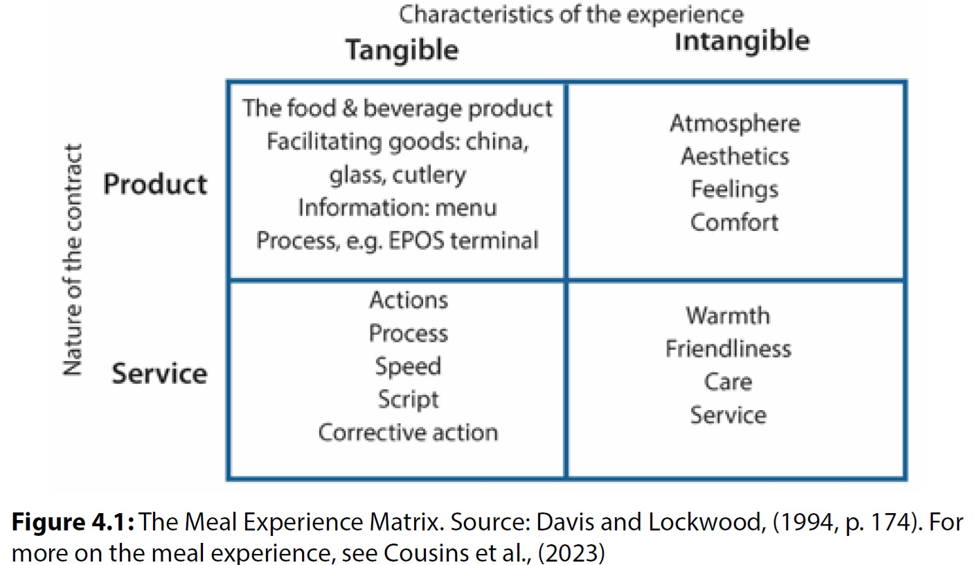
The Meal Experience

Slide 9
Other models
Other models that have been developed to assist in the understanding of the meal experience
An example is the five-aspect meal model (FAMM):
  Room – Meeting – Product - Control System – Atmosphere
These models and frameworks enable the operator, and the consumer to evaluate and discuss the operation against several values:
  Price v. Service
  Food v. entertainment “eater-tainment”
  Product attributes.

Slide 10
Food service delivery
Service delivery can be identified as sequential steps of inputs, processes and outputs which are quantified and controlled.
This approach applies manufacturing logic to service delivery, and a managerialist framework enabling delivery
It contributes to: Efficiency; Predictability; Calculability; Control.
Food service is complex due to the nature of the intangible elements which are delivered through the tangibles
These major elements are also referred to as the hard and soft aspects

Slide 11
Customer Processing Issues
Customer needs
Type and style of operation
Type of customers
Pricing policy
Opening hours
Availability of staff
Production process
Volume of demand
Volume of throughput
Space available
Booking requirements
Payment requirements
Legal requirements

Slide 12
Food service delivery systems
Table service: the customer is served at a laid table. This includes plated service (American) and silver service (English), Butler service and Guéridon service, (sometimes called French service)
Assisted service: the customer is served part of the meal at a table and is required to obtain part through self-service from a display or buffet
Self-service: the customer is required to help themselves from a buffet or counter
Single point service: the customer orders, pays and receives the food and beverages, at the same time, at a counter, in a bar, in fast-food or at a vending machine.
Specialised service or in situ service: delivery is taken to and served where the customer is located. E.g. tray service in hospitals, on aircraft, trolley service on trains, home delivery, lounge and room service.

Slide 13
Maintaining food service
The sequence of food service from production (kitchen), through service delivery to customer management needs to be considered to ensure that:
  Service level is maintained and in keeping with the concept style
  Availability of service is maintained
  Level of standards is delivered by all
  Reliability of service and consistency is maintained
  Flexibility of service to allow for deviation for different customer demands and needs

Slide 14
Maintaining food service (cont’d)
Managing food service effectively requires the delivery of high standards and consistency of customer experience through ensuring:
  Standard service
  Standard approach
  Standard engagement
  Standard dress
  Standard interaction
These should all be documented in Standard Operating Procedures (SOPs)

Slide 15
Menu management
The key influences on menus include:
  The relationship between health and eating
  Dietary requirements
  Prominent chefs and media
  Trends, fads and fashions
  Ethical and sustainability considerations

Slide 16
Menu design
Based on a balance of:
Colour, texture, flavour.
Nutritional balance.
Sequence (Order of dishes).
Language
Being legal
Menu attributes
Set the theme and reflect the brand through:
  Colour.
  Size.
  Image
  Set the tempo / customer turnover
  Marketing / Merchandising Opportunities

Slide 17
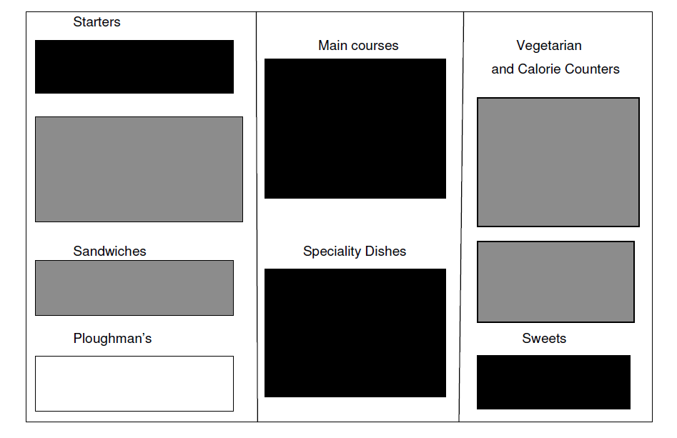
Menu design and layout
Speciality dishes that reflect the brand and contribute higher margins are placed in the middle section of the menu
Starters with high gross profit levels are at the top of the first column or if not then highlight them in some way
Desserts are profitable and placed at the end corner of the menu or display them in the eating area, on service counters
Attract the customer’s eye to other areas of the menu by using techniques such as colour, boxes, italics and illustrations or photographs

Slide 18
Menu Engineering
Primarily a pricing and marketing tool. It is based on the understanding of:
  Volume sold of one item over others
  Understanding the cost and hence profits of each dish (contribution)
  Pricing strategies
  Market price

Slide 19
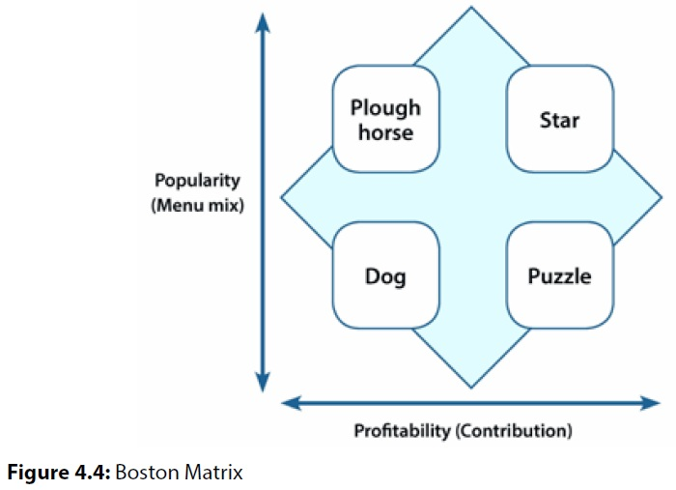
Menu Engineering (cont’d)
The principle of menu engineering is to achieve more profitable menus by adjusting prices and food costs according to:
  Number sold (popularity)
  Contribution towards fixed costs – the difference between revenue (less VAT) and food cost (profitability)
Menu items are categorised as:
  Plough House, Star, Dog and Puzzle

Slide 20
Menu engineering classifications
Stars are good dishes that are both popular and profitable
Puzzles are potentially profitable, but they are not selling, this is often because of one or more of the following:
  They are not very good
  They are overpriced
  They are the wrong dishes
Dogs are the poor performers, less popular and less profitable, generally poor new dishes
Plough horses are the workers on the menu - the only problem is that they are not very profitable

Slide 21
Balanced Scorecard
The Balanced Scorecard (BSC) is a management system not a measurement system.
The framework derives from the business mission statement and measures performance in four perspectives:
  Finance (how do look to the owners/shareholders?)
  Customers (how do customers see us?)
  Internal business processes (what must we excel at?)
  Learning and growth (can we improve and create value?).
It is a powerful tool, but it does have some drawbacks.
The Balanced Scorecard is further discussed in Chapter 10

Slide 22
Food and drink legislation
Premises
Premises licence (England and Wales)
Alcohol licensing
Personal licences
Licence to play live or recorded music
Entertainment Licensing
Food Standards Agency
Employment law
Deduction for wages.
Minimum wages.
Paid holidays.
Discrimination.
Maternity leave.
Dismissal.
Sick pay.

Slide 23
Food and drink legislation (cont`d)
Money and Taxes
  Payroll taxes.
  Sales Tax (VAT).
  Financial records of the trading of the business.
The Premises Licensing
  Premises License Holder
  Weights and Measures
  The Consumer Protection
  PRS and PPL Licence (The Music Licence)
The Companies Acts
Data Protection
The Health and Safety
Health and Safety at Work
Food Allergen labelling
Food Hygiene Rating Scheme
Employers’ Liability

Slide 24
Menu display and ethical values
The service and delivery of the food and drink products brings responsibility, moral questions and dilemmas
Some of the challenges and debates are:
  Use of language which could be offensive or degrading
  Staff who are employed because they fit the brand image and project a style
  Dishes on the menu that perhaps containing certain foods which some consider controversial, such as foie gras, caviar, and veal.
Cultural values and norms change over time
Operators need to develop and identify their own organisation’s morale compass.

Slide 25
Tipping
Motivates servers to deliver good service
Measures server performance
Identifies dissatisfied customers
Can create disharmony through the way staff manage the distribution of tips
Needs a system that is fair and does not discriminate
In some countries legislation is used to regulate tips
Must be declared for taxation purposes

Slide 26
Service charge
Can be contentious:
  A `hidden` charge added to the final bill
  Charges which customers must opt out of
  In the UK the law states in the Employment (Allocation of Tips) Bill 2022-23 that all service charges must go to the workers.
  For some customers this has the removed the reason to tip, and with it the discretion to reward the server

Slide 27
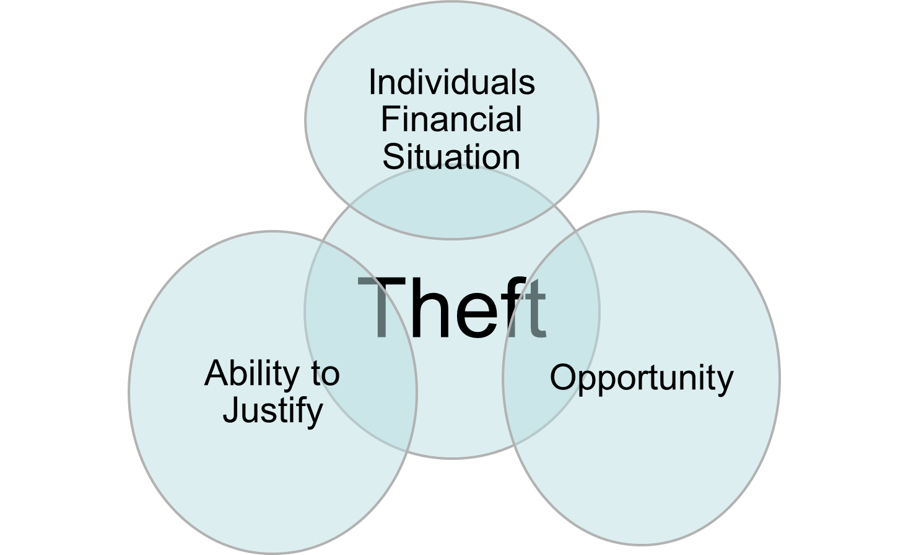
The Theft Triangle
Many employees only steal because they know they can and their chances of getting caught are slim
Knowing there is a system in place to trace theft, reduces the likelihood to steal
The theft triangle identifies if the opportunity element can be eliminated then the likelihood of theft is vastly reduced

Slide 28
Summary
Food service can be framed within the service paradigm to enable an evaluation of the process and key elements which contributes to it
Successful menu writing, design and evaluation of the menu mix is a core function to enable success and drive profitability
Legislations frames the manner and approach in which operators design and deliver the food service delivery
Food service operators need to mindful and develop strategies to manage tipping, service charges and aware of the scourge of theft both from customers and staff

Slide 29
Revision Questions
List the food service styles and how these link across to the offer and their importance
Menu management is a core function. Review an online menu and evaluate its effectiveness using the key points of menu writing
Consider tipping and service charges as a covert costs of the menu for the customer and reflect upon the impact

Slide 30
End of Chapter 4 presentation

Slide 31
Culinary and Food Service Operations Management for Industry 5.0
David Graham is an Associate Head at Sheffield Hallam University within Sheffield Business School, a visiting Research Fellow at the University of Zululand, South Africa and Principal Fellow of Higher Education Academy.
Ewen Crilley is a Senior Lecturer at Sheffield Hallam University and Course Leader for UG and PG Tourism, Hospitality, Culinary and Aviation.
Peter Cox worked in the hotel and contract catering for large international companies. He was a Senior Lecturer at Leeds Beckett University specialising in quality and hospitality operations management.
John Cousins is a consultant, educator, and the author of a range of food and beverage management and service publications, He has been conferred at Culinary Arts Laureate and is Director of the Food and Beverage Training Company.
© 2026 David Graham et al. Culinary and Food Service Operations Management for Industry 5.0 Goodfellow Publishers

